Slide 1
Investment Banking and Capital Market Domain
Ravi B Nangare
9423111564 / 8830158607

Slide 2

Course Overview:
Duration of course around 8 hrs.
Target Audience:
Candidate with little or no knowledge in Banking and Finance.
History of Investment Banks
Financial Instruments
Primary and Secondary market
Financial Instruments
Equity and Debt
Common Stock
Preferred Stock
Bonds and their Types
Derivative and their types

Slide 3
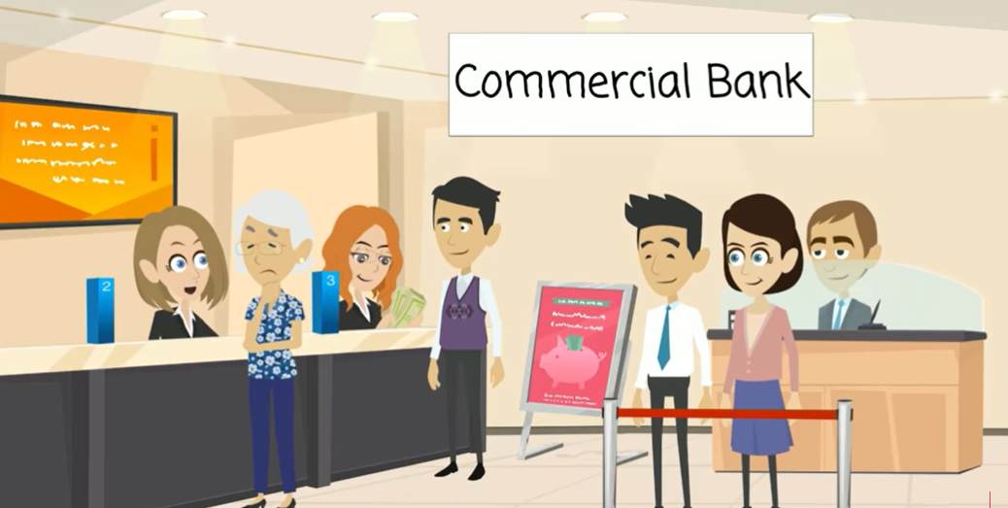
Commercial Bank:
Keeping money safe/allowing withdrawals when needed.
Issuance of chequebooks can be used for payments.
Provide personal loans, commercial loans, and mortgage loans.
Issuance of credit cards and Debit cards.
Allow financial transactions at branches.
Provide internet banking system to facilitate the customers to view and operate their respective accounts through internet.
Accepting the deposits from customer and provide the credit facilities to them.
Sell investment products like mutual funds Etc.

Slide 4
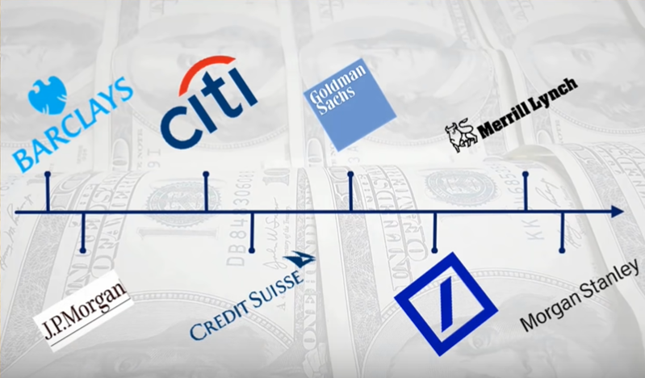
History of Investment Banks
1690
1812
1869
1941
1799
1856
1870
1935

Slide 5



How Investment Bank came into picture ?

Slide 6


Slide 7
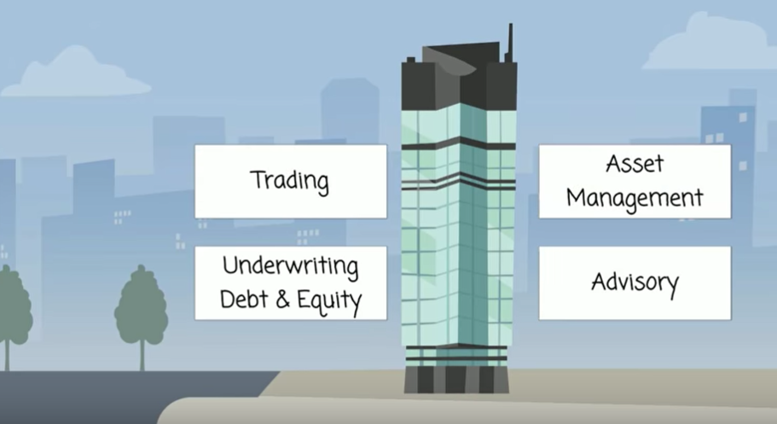
Key Functions of Investment Banking
Underwriting Debt and Equity
Advisory
Trading
Asset Management

Slide 8
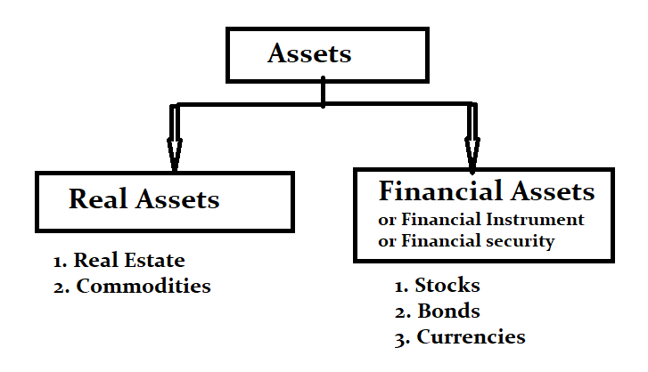
Financial Instruments:
Capital can be raised by below financial securities:
Equity/Stocks
Debt(or Fixed Income)/ Bonds
Assets Types:

Slide 9
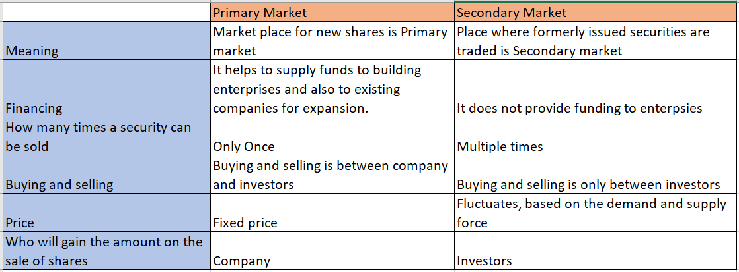
Primary and Secondary markets:
Primary Market: IPO (Initial Public offering)
Secondary Market: Exchange

Slide 10
Equity:
Equity (or Stock) is viewed by the market as an ownership "share" in the revenue stream of a corporation' s income once all prior obligations and debts have been satisfied. There are two types of equity:
Common Stock
Preferred Stock
Common Stock: As the name suggests common stock is the most common method of providing stocks in a company. The characteristic feature of this stock is that the holder of is entitled to voting rights as well as the dividends. Important point to note is that there is no guarantee of dividends
Preferred stock: Preferred stock is the stock in which the owner has a guaranteed dividend payment at a specified rate. It represents ownership in a corporation, but it does not have the voting rights as common stocks Although preferred stock does not typically have the same growth potential as common stock, it does have two distinct advantages over common stockholders. No dividends can be paid to common shareholders before obligations to preferred shareholders are met Preferred stock also has priority claims over common stock

Slide 11
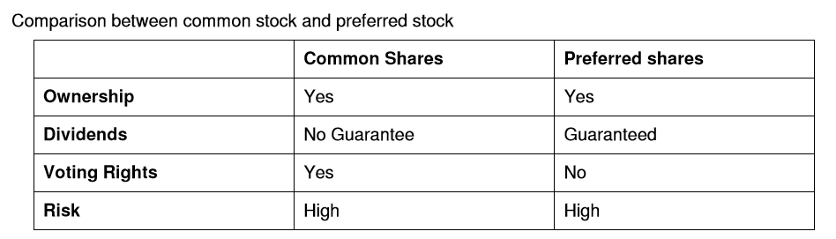
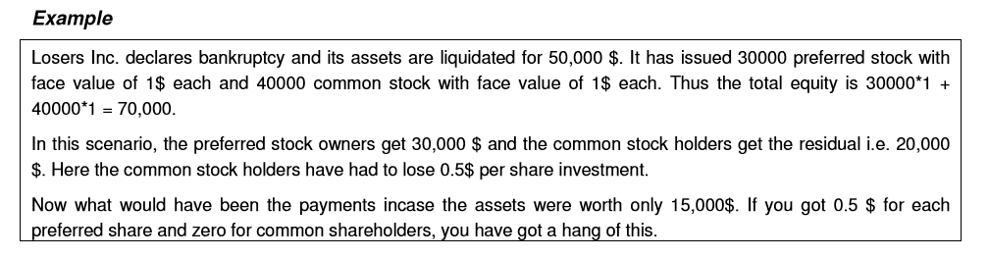

Slide 12
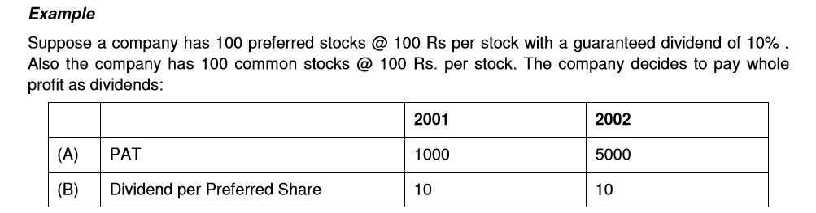
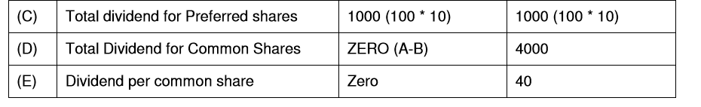
Why would anyone want a common stock? After all preferred stock does guarantee a fixed payment. The answer is simple. Preferred stock is like giving someone a loan. You get a confirmed dividend payment for a fixed amount that you have invested. But in case the company does better than expected, the common stock holders get a much higher payment than the preferred stock holders. The following example will make it clearer:

Slide 13
Bonds:
A bond is a fixed income instrument that represents a loan made by an investor to a borrower (typically corporate or governmental).
A bond could be thought of as an I.O.U. between the lender and borrower that includes the details of the loan and its payments. Bonds are used by companies, municipalities, states, and sovereign governments to finance projects and operations.
Bond details include the end date when the principal of the loan is due to be paid to the bond owner and usually includes the terms for variable or fixed interest payments made by the borrower.
Some of the basic terminology that you will need to know initially is:
• Par Value/Face Value - The principal amount that is returned at the end of the maturity is known as the Par value. It is also known as the principal or face value.
• Coupon Rate - It is the annual rate of interest on the bond' s face value that a bond' s issuer promises to pay the bondholder.
• Coupon – The amount that is being paid to bind holders as per agreed frequency.
• Maturity period/Term to maturity - Date on which the principal or nominal value of a bond becomes due and payable in full to the holder.
Maturities range significantly, from 1 month for some municipal notes to 40+ years for some corporate bonds.

Slide 14
Classification of bonds Bonds can be divided into following categories:
• Central Government Bonds (Treasuries).
• Municipal Bonds
• Corporate Bonds : Collateral Trust, Mortgage, Zero Coupon
Supranational bond : It is a long-term form of debt that transcends the boundaries of a single country. These are very similar to government bonds, and tend to have a high credit rating.
Issues by World Bank/ IMF.
Government Bonds : Treasury/ Central Govt Bonds/ Sovereign Bonds
When a government borrows money they are called as treasury instruments. E.g. RBI in India, Federal in US.
Treasury instruments can be of three types. Treasuries are highly liquid and have the lowest risk:
• Treasury bills (T-bills): These instruments mature with in a year. Thus these are short-term loans.
• Treasury notes: These are the bonds that mature within one to ten years.
• Treasury bonds: These are the bonds, which mature after ten years.

Slide 15
Municipal Bonds: The local government issues these bonds. In US these bonds are exempt from taxes from federal as well as state governments, thus these are very popular. But since these bonds are tax exempted, their returns are lesser to the comparable bonds.
Corporate Bonds: Corporate Bonds are fixed income securities issued by the industrial corporate, public utility corporations etc. to raise funds for their projects.
This can be issued by Financial and non financial companies.
Since the corporates have different risks, the returns that they give vary. Generally a corporate having more risk of default will be offering a higher rate of return. Some of the important types of corporate bonds are:
Mortgage Bonds This is a bond secured by a mortgage on a property. The value of the property may or may not equal the value of the bonds issued against it.
Collateral Trust Bonds: As an alternative to pledging fixed assets or property, a borrower can pledge financial assets such as stocks, bonds, T-bills etc.
Zero Coupon bonds: Typically a bond has got coupon payments throughout its life. But a certain kind of bond does not pay the coupons during the lifetime of the bond. They are issued at a discount from face value and redeemed at the face value on maturity. The difference between the purchase price of the zero and its face value when redeemed is the investor' s return. For example: A zero coupon bond of face value $100 and maturing in 5 years will be offered at $73.85 thus giving an annual coupon of 6.25%

Slide 16
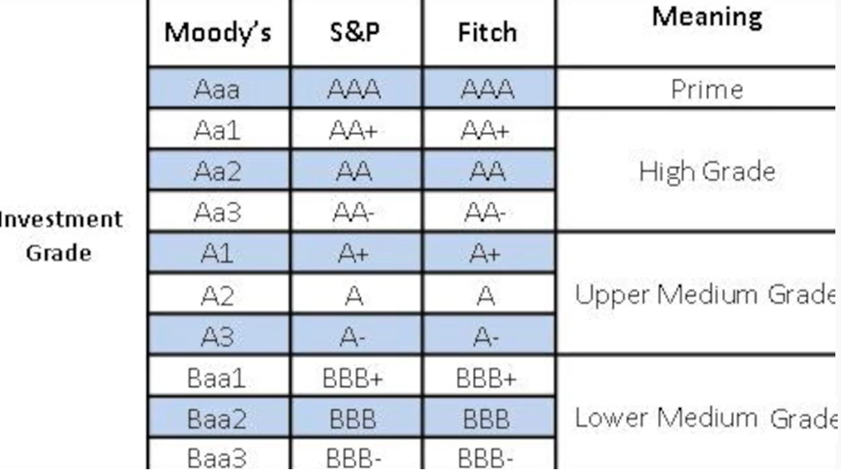
Rating of Bonds:

Slide 17
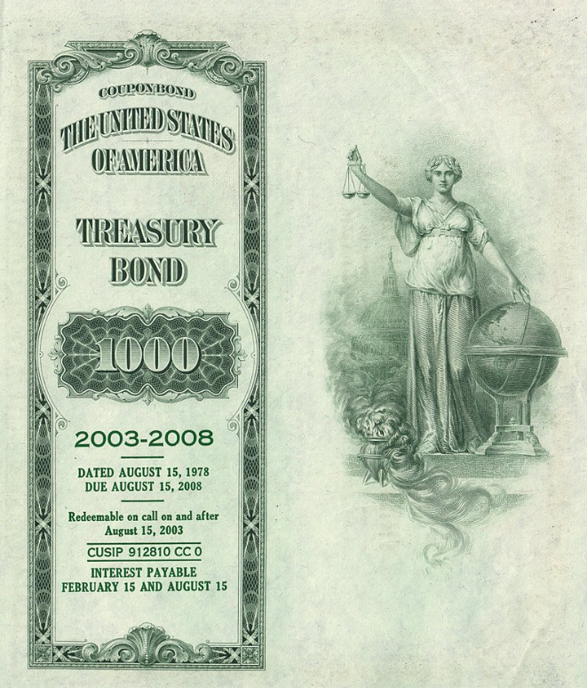
Bond in actual:

Slide 18
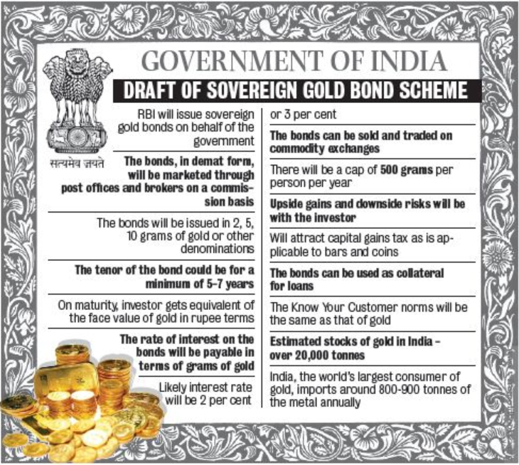

Slide 19
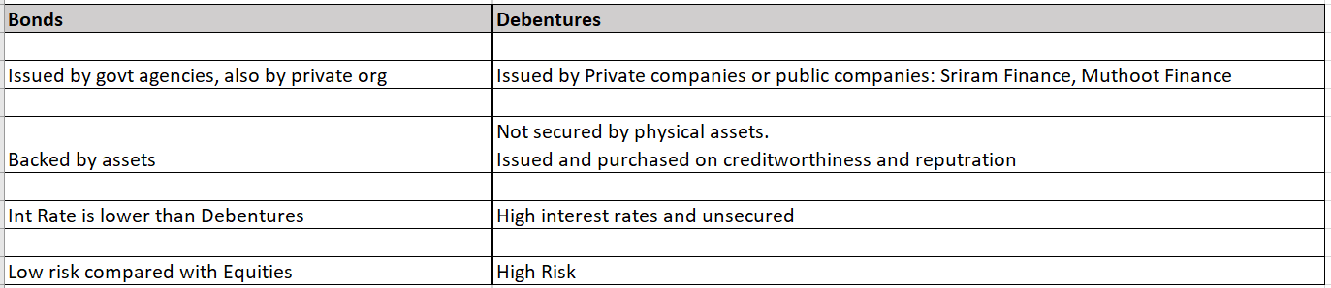
Difference between Bonds and Debentures:

Slide 20
Inverse to Interest Rates
This is why the famous statement that a bond’s price varies inversely with interest rates works.
For investors to understand how a bond premium and bond discount works, we must first explore how bond prices and interest rates relate to each other. As interest rates fall, bond prices rise while conversely, rising interest rates lead to falling bond prices in order to have the effect of equalizing the interest rate on the bond.
Because of this Bond trading is as below:
- Trading at Premium: This happens when Interest rate falls.
Bond trading above its face value or in other words; it costs more than the face amount on the bond.
A bond that's trading at a premium means that its price is trading at a premium or higher than the face value of the bond.
For example, a bond that was issued at a face value of $1,000 might trade at $1,050 or a $50 premium. Even though the bond has yet to reach maturity, it can trade in the secondary market.

Slide 21
- Trading at discount: This happens when Interest rate rises.
Bond currently trading for less than its face value in the secondary market is said to be trading at discount.
Interest rates rise after an investor purchases a bond. The higher interest rate in the economy decreases the value of the newly-purchase bond due to paying a lower rate versus the market.
Many bonds are issued with a $1,000 face value meaning the investor will be paid $1,000 at maturity. However, bonds are often sold before maturity and bought by other investors in the secondary market. Bonds that trade at a value of less than face value would be considered a discount bond. For example, a bond with a $1,000 face value that's currently selling for $950 would be a discounted bond.

Slide 22
DERIVATIVES:
Derivative is a product whose value is derived from the value of underlying asset.
The underlying asset can be equity, forex, commodity, bond, Index or any other asset.
For example, wheat farmers may wish to sell their harvest at a future date to eliminate the risk of a change in prices by that date. Such a transaction is an example of a derivative. The price of this derivative is driven by the spot price of wheat which is the “underlying”.
In the Indian context the Securities Contracts (Regulation) Act, 1956 (SCIA) defines derivatives to include :
1. A security derived from a debt instrument, share, loan whether secured or unsecured, risk instrument or contract for differences or any other form of security.
2. A contract which derives its value from the prices, or index of prices, of underlying securities.

Slide 23
DERIVATIVE PRODUCTS
Derivative contracts have several types. The most common types are forwards, futures, options and swaps.
We take a brief look at various derivatives contracts that have come to be used.
Forwards: A forward contract is a customized contract between two entities, where settlement takes place on a specific date in the future’at today's pre-agreed price.
Futures: A futures contract is an agreement between two parties to buy or sell an asset at a certain time in the future at a certain price. Futures contracts are special types of forward contracts in the sense that the former are standardized exchange-traded contracts.
Options: Options are of two types - calls and puts. Calls give the buyer the right but not the obligation to buy a given quantity of the underlying asset, at a given price on or before a given future date. Puts give the buyer the right, but not the obligation to sell a given quantity of the underlying asset at a given price on or before a given date.
Warrants: Options generally have lives from a week to few months.
The majority of options traded on exchanges having a maximum maturity in few months. Longer-dated options are called warrants and are generally traded over-the-counter – These are having maturity more than a year.

Slide 24
Swaps: Swaps are private agreements between two parties to exchange cash flows in the future according to a prearranged formula. They can be regarded as portfolios of forward contracts. The two commonly used swaps are:
• Interest rate swaps: These entail swapping only the interest related cash flows between the parties in the same currency.
• Currency swaps: These entail swapping both principal and interest between the parties, with the cash flows in one direction being in a different currency than those in the opposite direction.
Swaptions: Swaptions are options to buy or sell a swap that will become operative at the expiry of the options. Thus a swaption is an option on a forward swap. Rather than have calls and puts, the swaptions market has receiver swaptions and payer swaptions. A receiver swaption is an option to receive fixed and pay floating. A payer swaption is an option to pay fixed and receive floating.

Slide 25
EXCHANGE-TRADED vs. OTC DERIVATIVES MARKETS
As the word suggests, derivatives that trade on an exchange are called exchange traded derivatives, whereas privately negotiated derivative contracts are called OTC contracts.
The OTC derivatives markets have the following features compared to exchange traded derivatives:
1. The management of counter-party (credit) risk is decentralized and located within individual institutions,
2. There are no formal centralized limits on individual positions
3. There are no formal rules for risk and burden-sharing,
4. There are no formal rules or mechanisms for ensuring market stability and integrity, and for safeguarding the collective interests of market participants, and
5. The OTC contracts are generally not regulated by a regulatory authority and the exchange's self-regulatory organization.

Slide 26
PARTICIPANTS IN THE DERIVATIVES MARKETS
The derivatives market is similar to any other financial market and has following three broad categories of participants:
• Hedgers: These are investors with a present or anticipated exposure to the underlying asset which is subject to price risks. Hedgers use the derivatives markets primarily for price risk management of assets and portfolios.
• Speculators: These are individuals who take a view on the future direction of the markets. They take a view whether prices would rise or fall in future and accordingly buy or sell futures and options to try and make a profit from the future price movements of the underlying asset.
• Arbitrageurs: They take positions in financial markets to earn riskless profits. The arbitrageurs take short and long positions in the same or different contracts at the same time to create a position which can generate a riskless profit.

Slide 27
FORWARD CONTRACTS
A forward contract is an agreement to buy or sell an asset on a specified date for a specified price.
One of the parties to the contract assumes a long position and agrees to buy the underlying asset on a certain specified future date for a certain specified price. The other party assumes a short position and agrees to sell the asset on the same date for the same price. Other contract details like delivery date, price and quantity are negotiated bilaterally by the parties to the contract. The forward contracts are normally traded outside the exchanges.
The salient features of forward contracts are:
• They are bilateral contracts and hence exposed to counter-party risk.
• Each contract is custom designed, and hence is unique in terms of contract size, expiration date and the asset type and quality.
• On the expiration date, the contract has to be settled by delivery of the asset.

Slide 28
Forward contracts are very useful in hedging and speculation.
The classic hedging application would be that of an exporter:
Exporter expects to receive payment in dollar i.e. 100$ three months later.
He is exposed to the risk of exchange rate fluctuations.
Current USD INR – 71.5
Case1: After 3 months: Exch Rate – 75 : 7500 INR
Case2: After 3 months: Exch rate – 65 : 6500 INR
By using the currency forward market to sell dollars forward, he can lock on to a rate today and reduce his uncertainty.
Similarly an importer who is required to make a payment in dollars two months hence can reduce his exposure to exchange rate fluctuations by buying dollars forward.

Slide 29
LIMITATIONS OF FORWARD MARKETS
Forward markets world-wide are afflicted by several problems:
• Lack of centralization of trading,
• Illiquidity, and
• Counterparty risk

Slide 30
INTRODUCTION TO FUTURES
Futures markets were designed to solve the problems that exist in forward markets. A futures contract is an agreement between two parties to buy or sell an asset at a certain time in the future at a certain price. But unlike forward contracts, the futures contracts are standardized and exchange traded.
The standardized items in a futures contract are:
• Quantity of the underlying
• Quality of the underlying
• The date and the month of delivery
• The units of price quotation and minimum price change
• Location of settlement

Slide 31
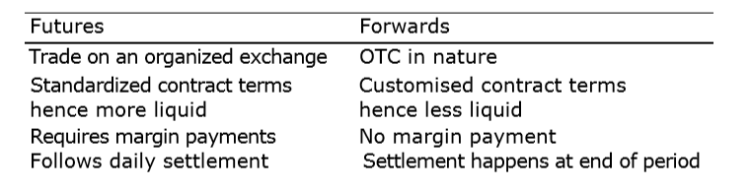
DISTINCTION BETWEEN FUTURES AND FORWARDS CONTRACTS
Forward contracts are often confused with futures contracts. The confusion is primarily because both serve essentially the same economic functions of allocating risk in the presence of future price uncertainty. However futures are a significant improvement over the forward contracts as they eliminate counterparty risk and offer more liquidity.

Slide 32
DISTINCTION BETWEEN FUTURES AND FORWARDS CONTRACTS
Forward contracts are often confused with futures contracts. The confusion is primarily because both serve essentially the same economic functions of allocating risk in the presence of future price uncertainty. However futures are a significant improvement over the forward contracts as they eliminate counterparty risk and offer more liquidity.

Slide 33
FUTURES TERMINOLOGY
• Spot price: The price at which an asset trades in the spot market.
• Futures price: The price at which the futures contract trades in the futures market.
• Contract cycle: The period over which a contract trades. The index futures contracts on the NSE have one-month, two-months and three months expiry cycles which expire on the last Thursday of the month. Thus a January expiration contract expires on the last Thursday of January and a February expiration contract ceases trading on the last Thursday of February. On the Friday following the last Thursday, a new contract having a three-month expiry is introduced for trading.
• Expiry date: It is the date specified in the futures contract. This is the last day on which the contract will be traded, at the end of which it will cease to exist.
• Contract size: The amount of asset that has to be delivered under one contract. Also called as lot size.
• Basis: In the context of financial futures, basis can be defined as the futures price minus the spot price. There will be a different basis for each delivery month for each contract. In a normal market, basis will be positive. This reflects that futures prices normally exceed spot prices.

Slide 34
• Cost of carry: The relationship between futures prices and spot prices can be summarized in terms of what is known as the cost of carry. This measures the storage cost plus the interest that is paid to finance the asset less the income earned on the asset.
• Initial margin: The amount that must be deposited in the margin account at the time a futures contract is first entered into is known as initial margin.
• Marking-to-market: In the futures market, at the end of each trading day, the margin account is adjusted to reflect the investor's gain or loss depending upon the futures closing price. This is called marking-to-market.
Current day mkt Value – Previous day mkt price*Lots * No of contracts.
• Maintenance margin: This is somewhat lower than the initial margin. This is set to ensure that the balance in the margin account never becomes negative. If the balance in the margin account falls below the maintenance margin, the investor receives a margin call and is expected to top up the margin account to the initial margin level before trading commences on the next day.

Slide 35
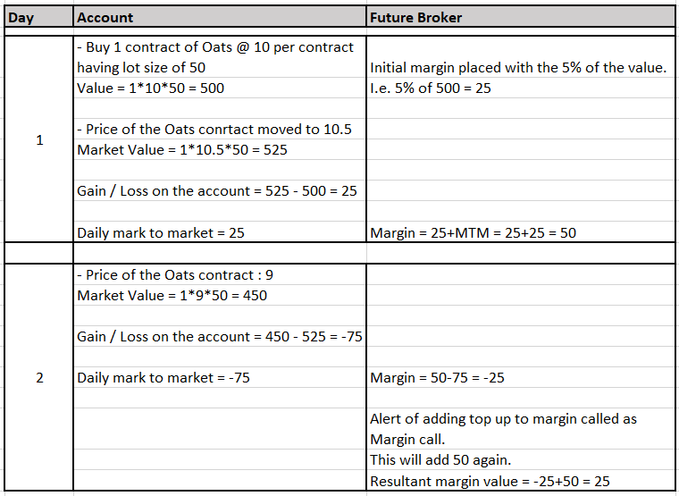
Calculation of Futures:

Slide 36
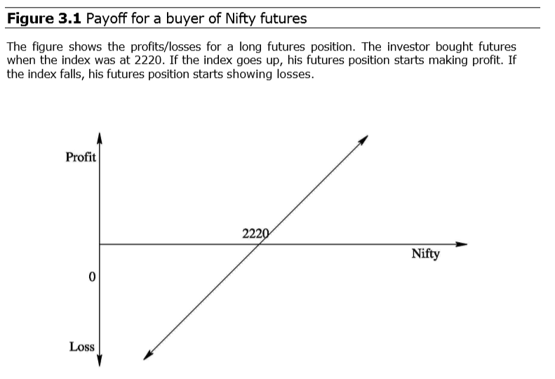
Payoff for buyer of futures: Long futures

Slide 37
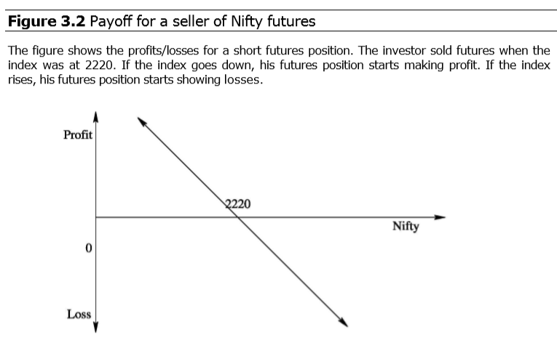
Payoff for seller of futures: Short futures

Slide 38
Thank You..!!

